Slide 1
BLOGOSPHERE
- Ajay Goel (001897443)
- Ankit Yadav (001271369)

Slide 2
Application objective:
Freedom of thoughts : Our application is based on writing your thoughts in form of posts which other users can read.
Blogosphere is a post based website where posts are made, edited, organized by its community of users in the form of posts.
Roles:
Admin can login and manage the posts along with the user management system.
Users can login, post, delete and edit the post.
Connectivity: We have used Mongo DB at the backend to store the user data and posts in form of documents/collections.
Using Blazor application to create server and client and from server we are making the connection with the database.
The client hits the server which then extract data from database.

Slide 3

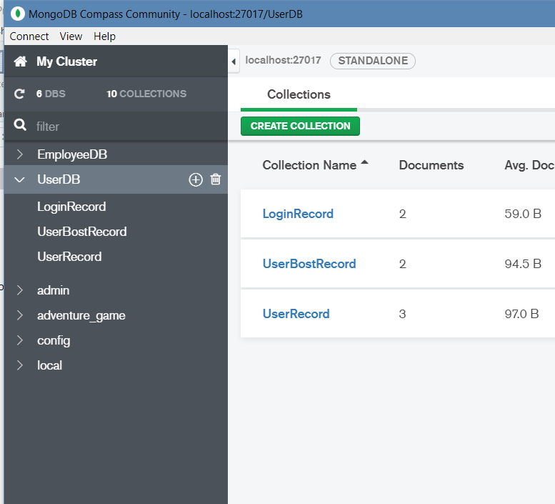

Database : Mongo db
Created a database:
UserDB
Created 3 collections:
LoginRecord
UserBostRecord: All the posts made by the user will be stored in this collection.
User Record: All the user data ie., the id, password and role type will be stored in this collection .

Slide 4
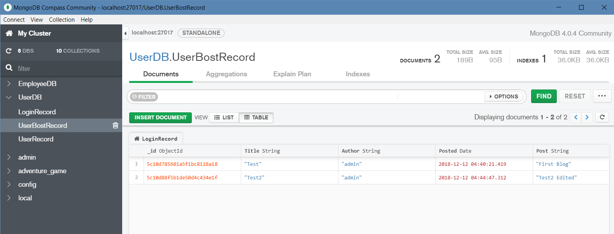
Screenshots: POST
Collection with the user posts are stored here along with the posted date, string and title.

Slide 5
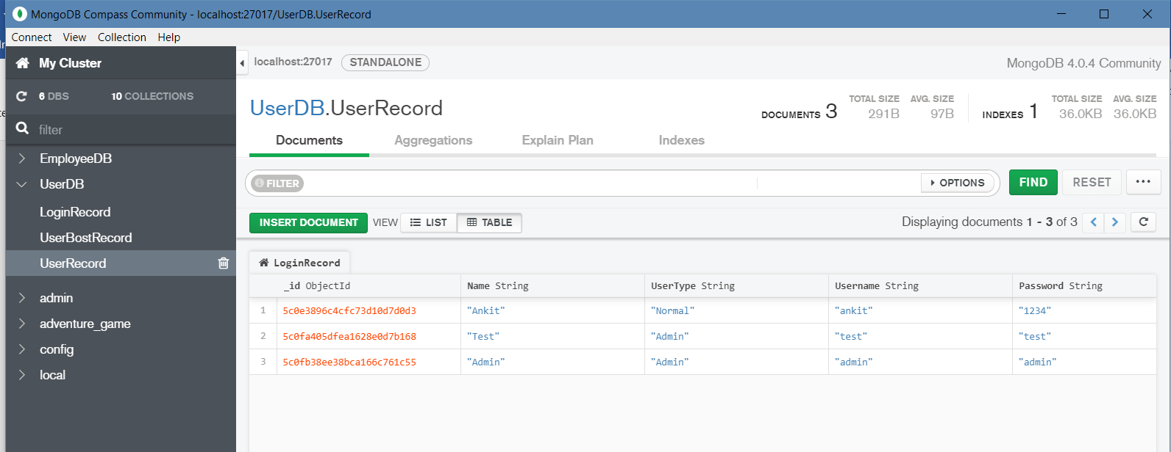
Screenshots : User record
User records data with the name, user type, password etc are stored in this collection.

Slide 6
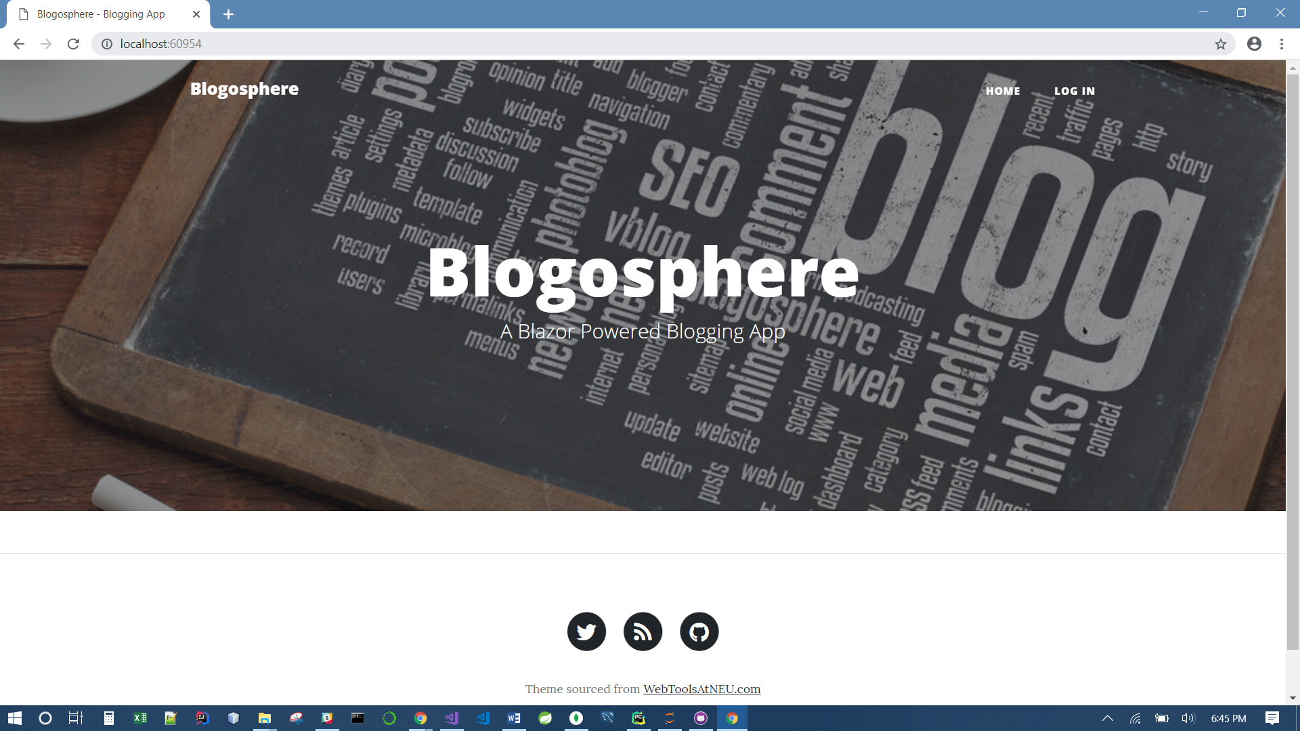
HOME - BLOGOSPHERE
Log in button will redirect you to login page.
Twitter label below will direct you to the twitter home page.
Github label will redirect you to github profile already coded in the client side.

Slide 7
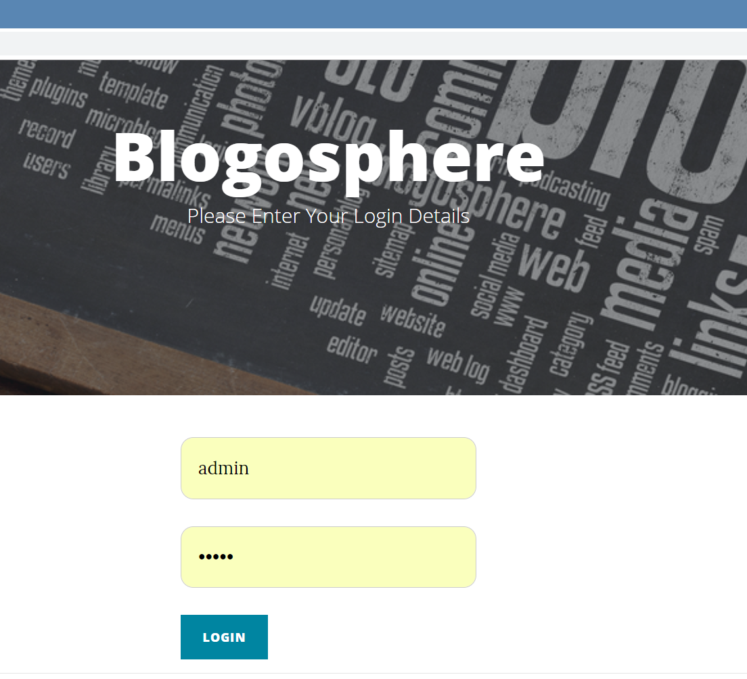
LOGIN PAGE
Enter the details as admin in username and password which will take you to the admin home screen.

Slide 8
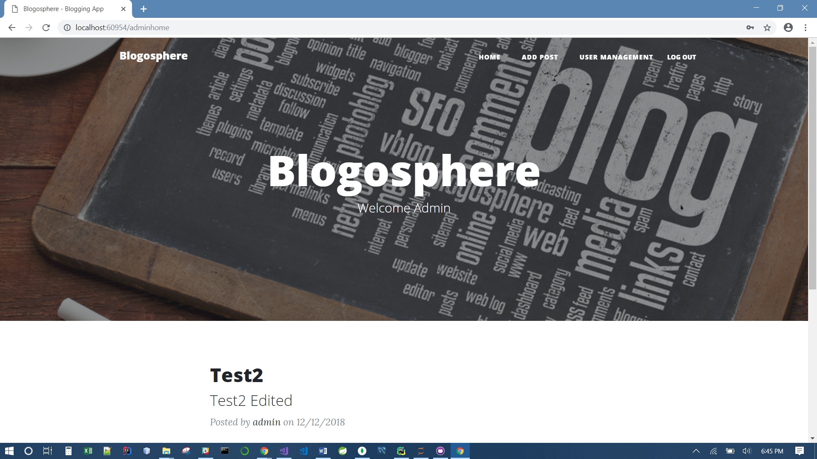
Admin home screen
Admin can add the posts by clicking on ADD POST button.
They can log out clicking on LOG OUT button.
User Management button will redirect the admin to the page where new users can be added or edited.
Home: All the posts with the timestamp will be visible here.

Slide 9
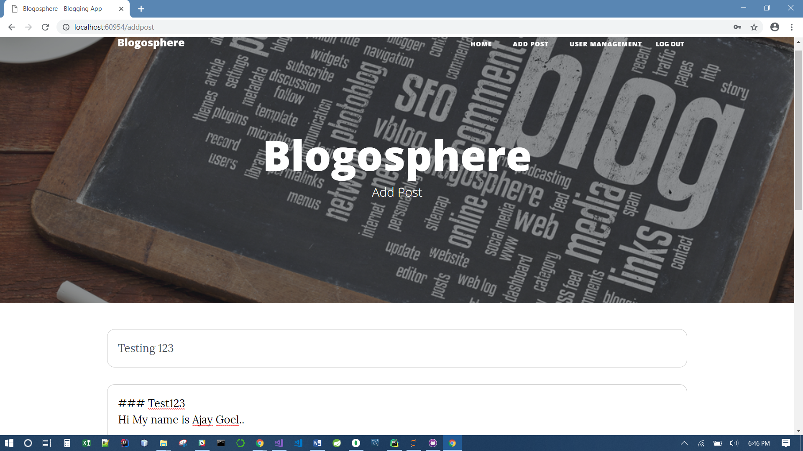
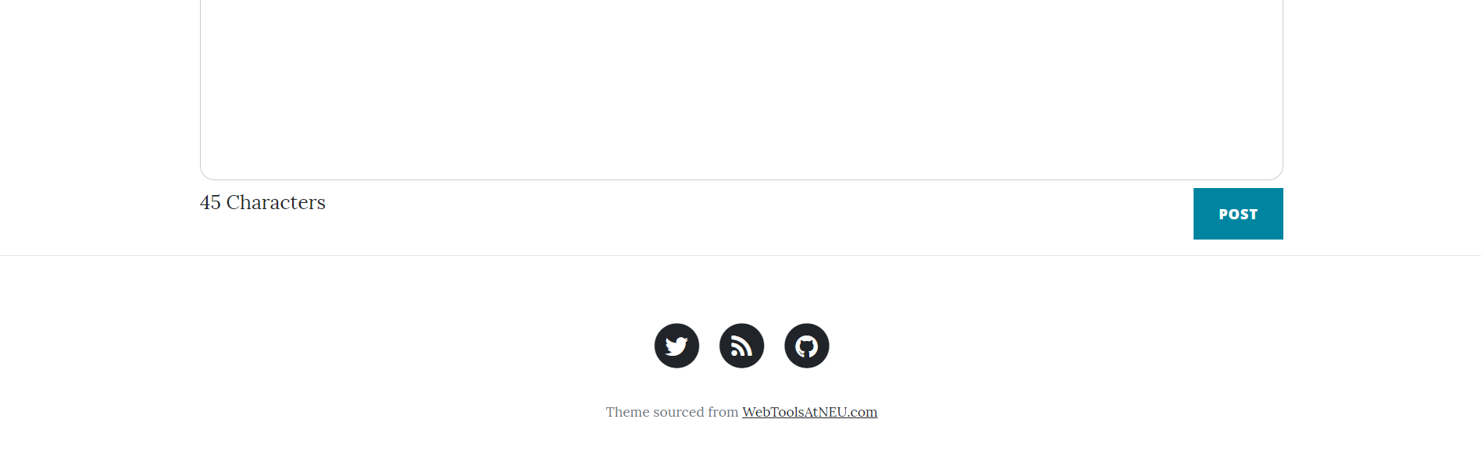
Adding a post : ADD POST button
The first text box will store the heading of the post.
The Second textbox will store the content of the post.
It is supported by markdown. So, we can use different sizes in the post.
Character count is also written to check the length of the post.
After clicking on post, data will be stored in a database.

Slide 10
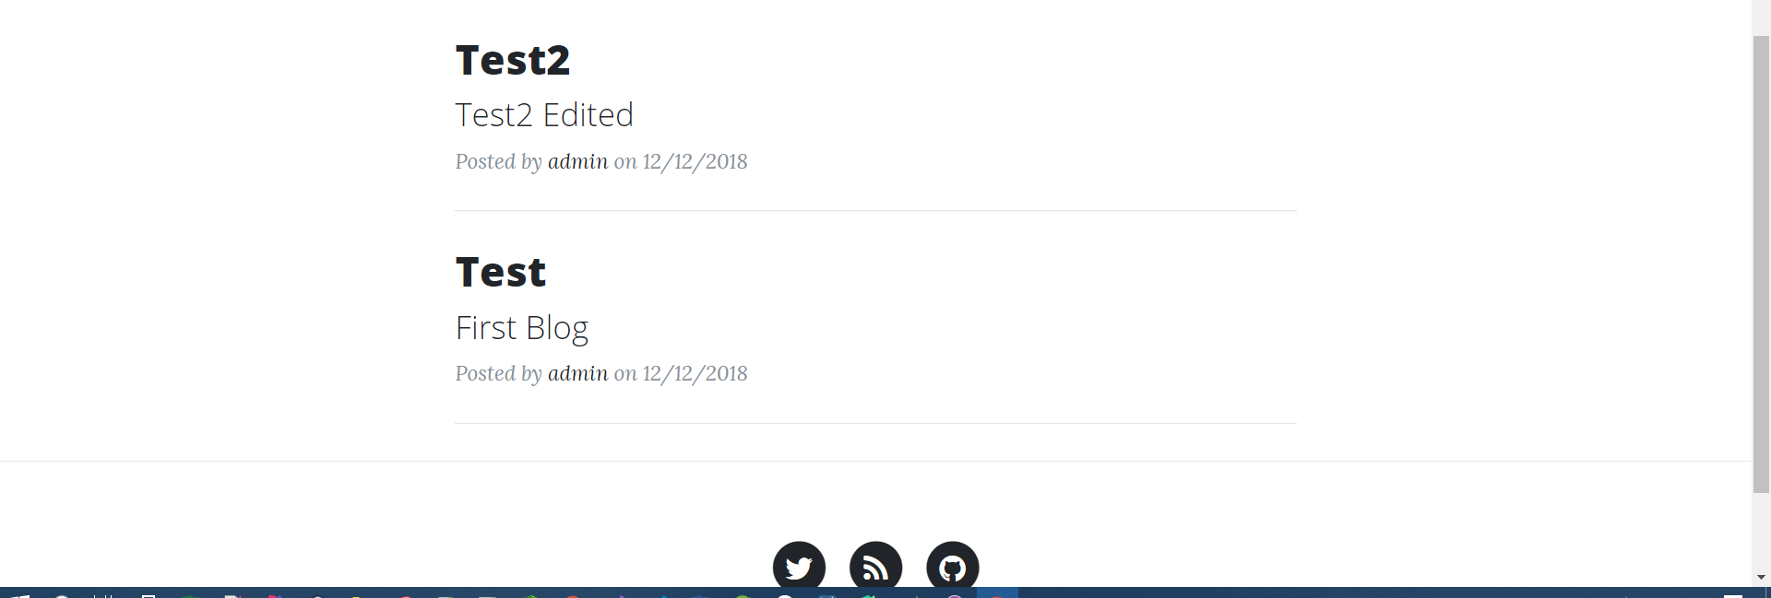
HOME – VIEW
We can view all the posts clicking on home button.

Slide 11
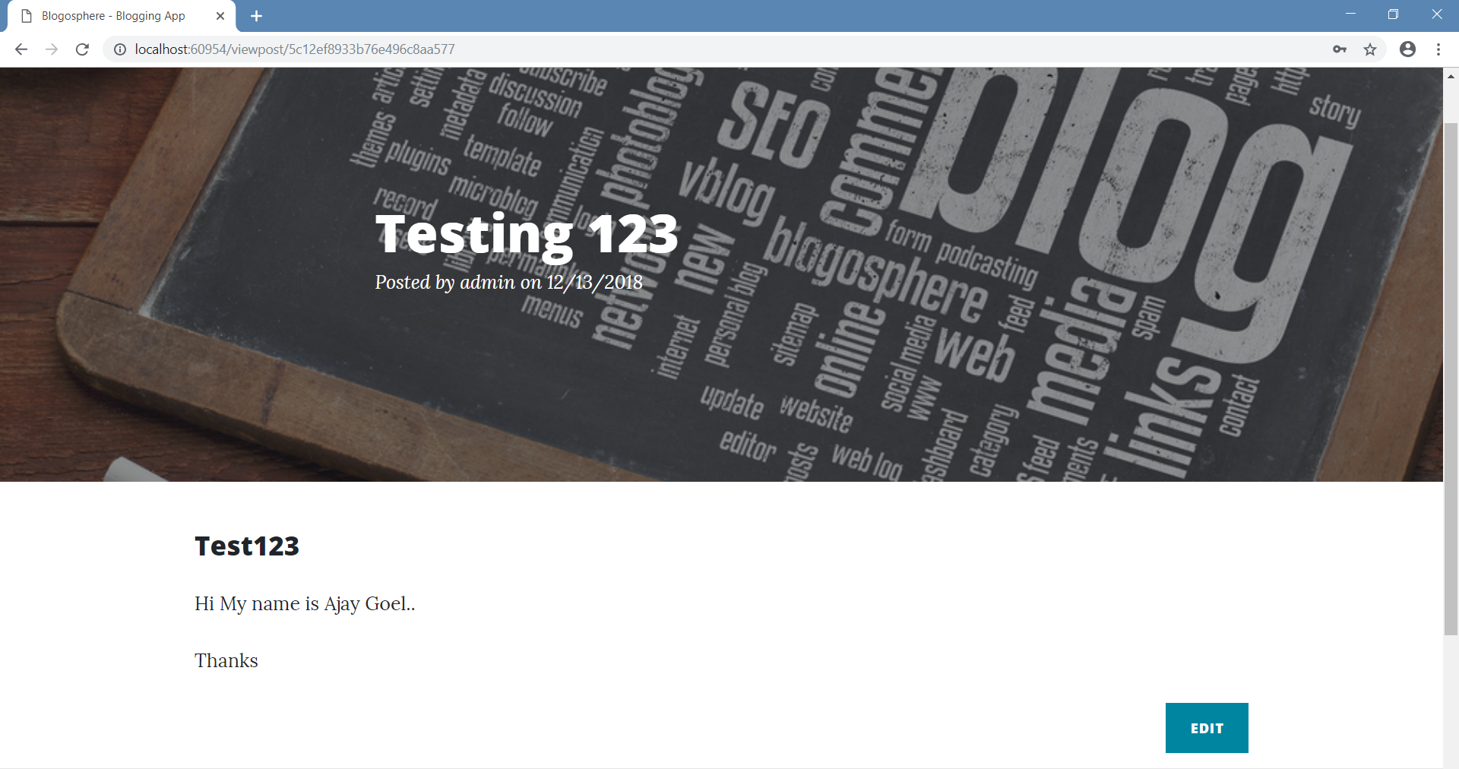
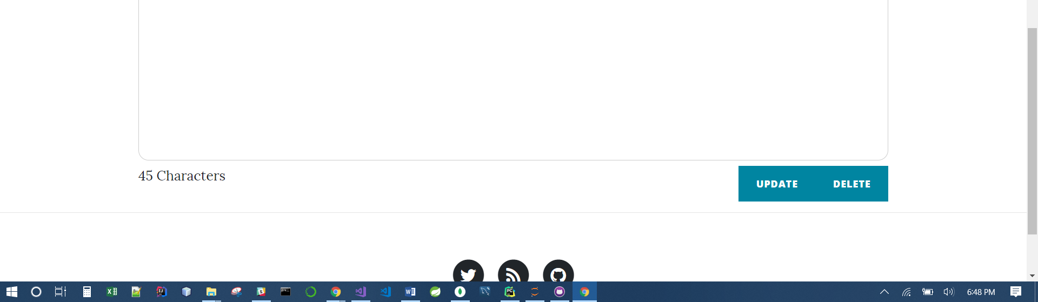
EDIT/DELETe POST
We can edit the post by clicking on edit button.
It can be deleted also.

Slide 12
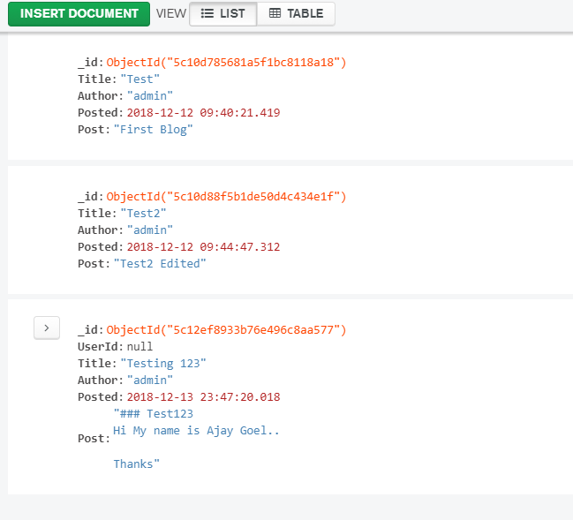
Database collection view
We can check if the data is stored in the database or not.

Slide 13
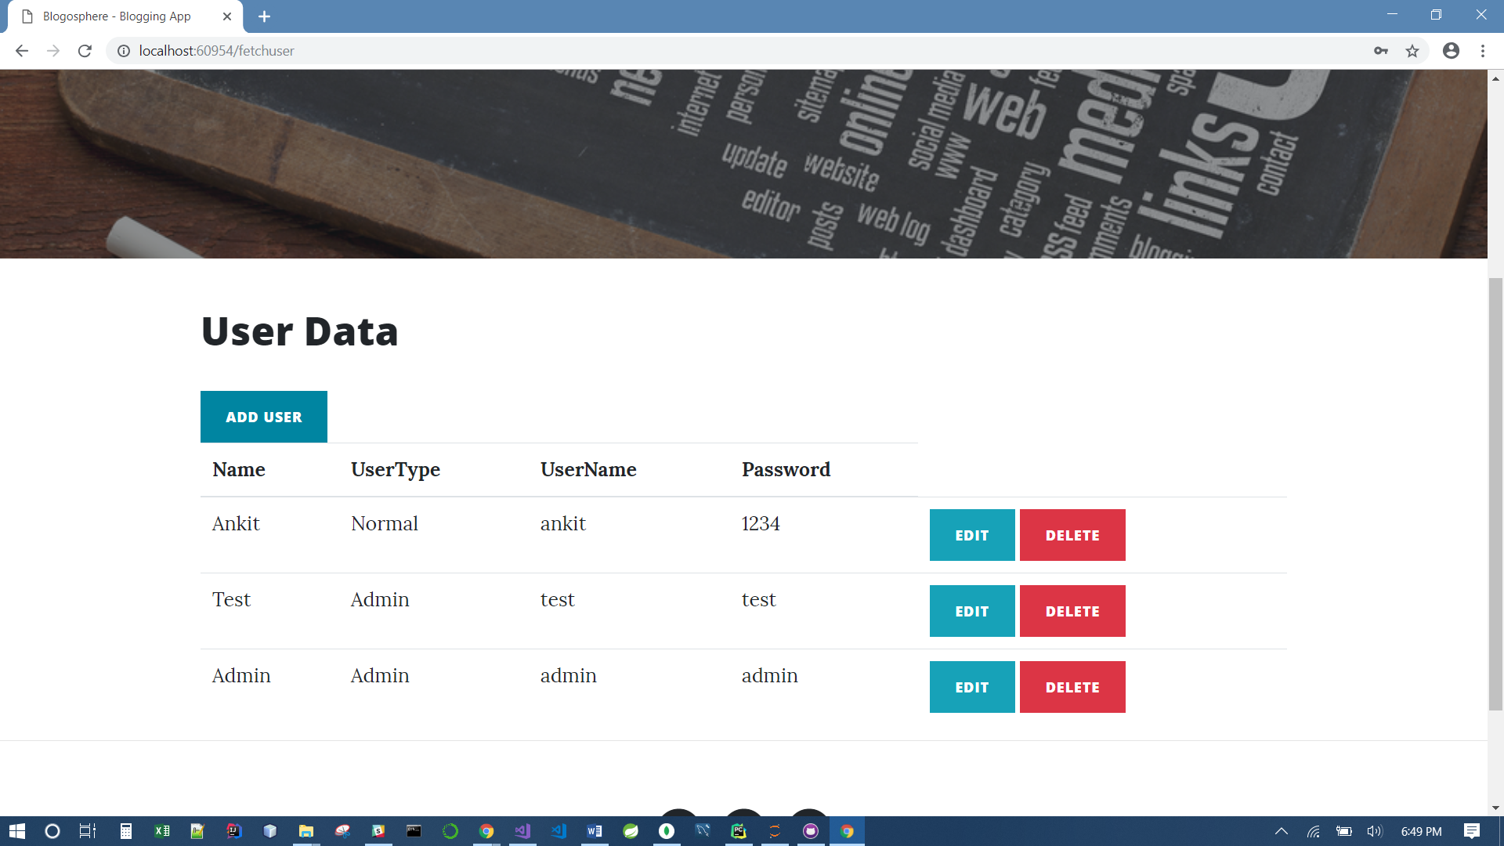
USER MANAGEMENT System
Users can be accessed from User Management Button.
It can be created, deleted and updated accordingly.

Slide 14
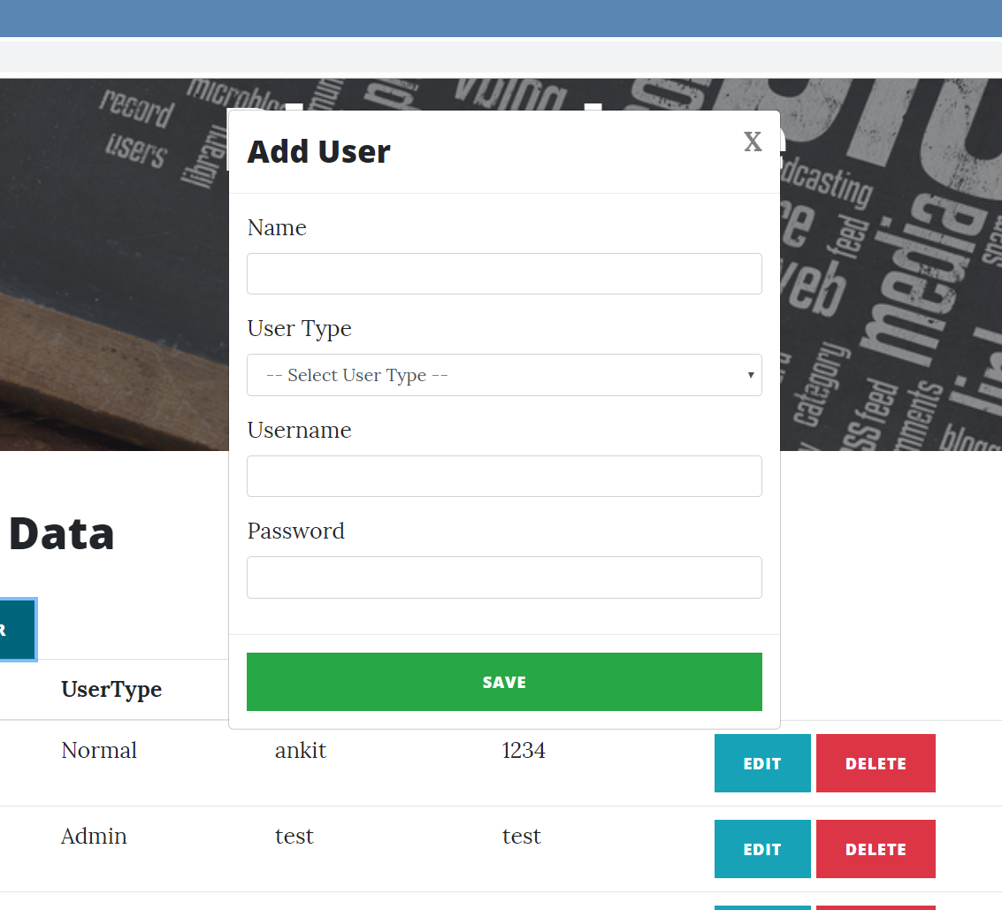
Add user
From this panel, user can be created.
It will be directly get saved in the database.

Slide 15
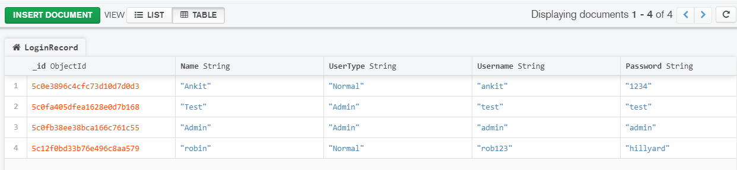
DATABASE VIEW
Data of the new user created Robin is available in the database.

Slide 16
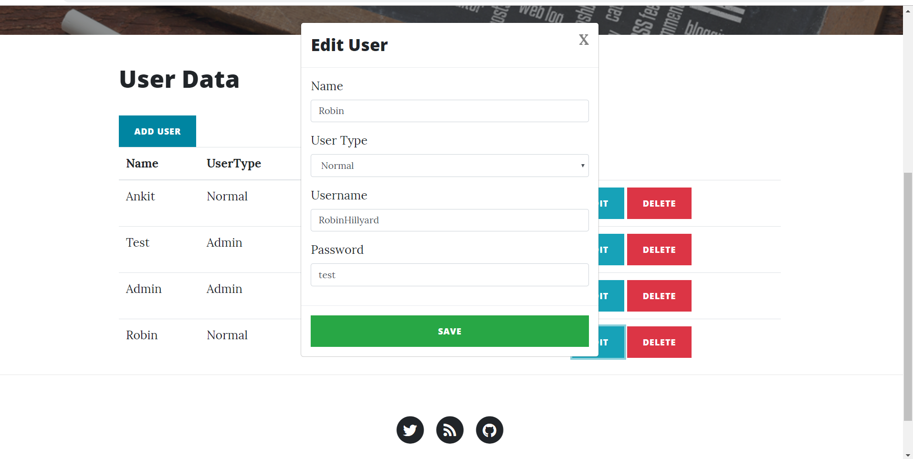
EDIT the user
We can edit the username and password of the user by clicking on EDIT button.

Slide 17
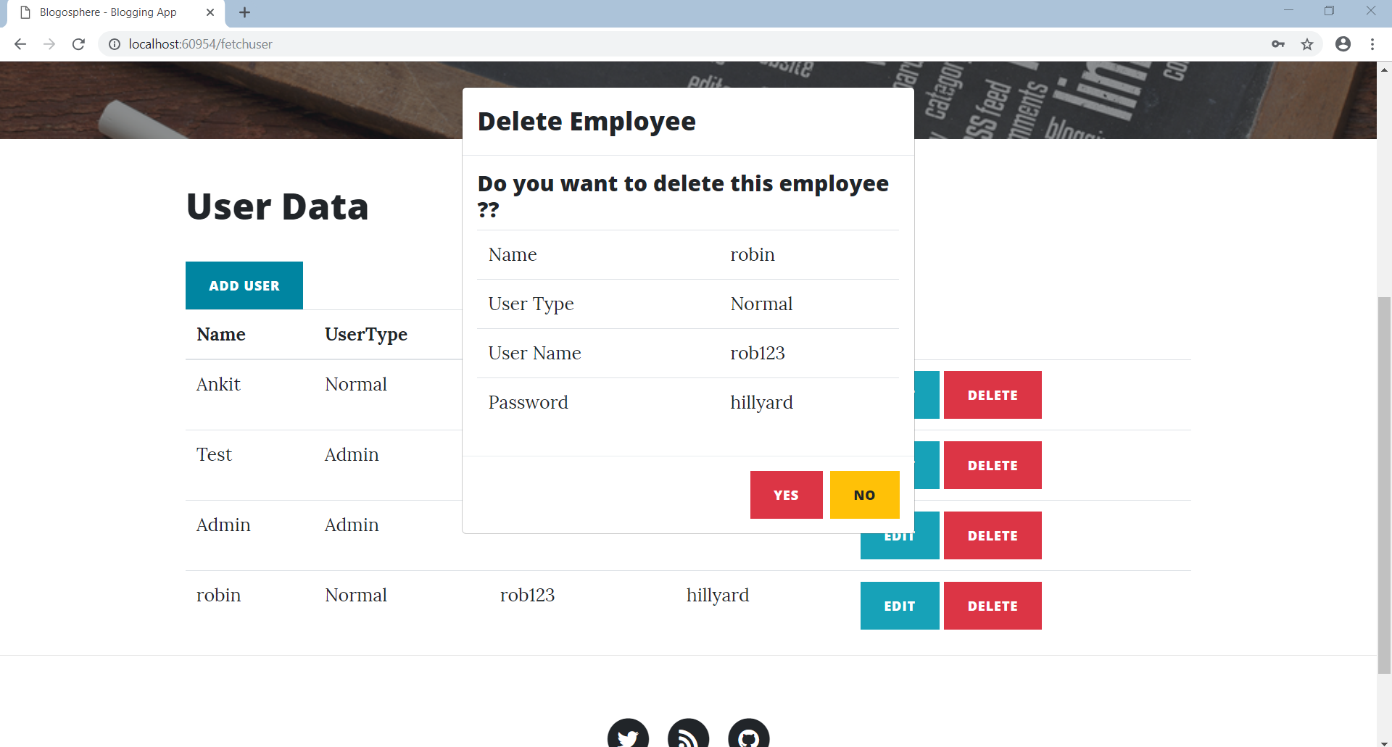
Delete the user
User can be deleted from the database also.

Slide 18
References:
https://blazor.net/
https://blazor.net/docs/
https://ankitsharmablogs.com/asp-net-core-crud-using-blazor-and-entity-framework-core/

Slide 19
THANK YOU

